Slide 1
Degital portfolio
Name : Rathi. K
Register Number : 2422K2331
Nm id : C8515B8F6EAF0F780F849A779BDC2752
Department:Computer Science
College : Government Arts&Science College Modakkurichi

Slide 2
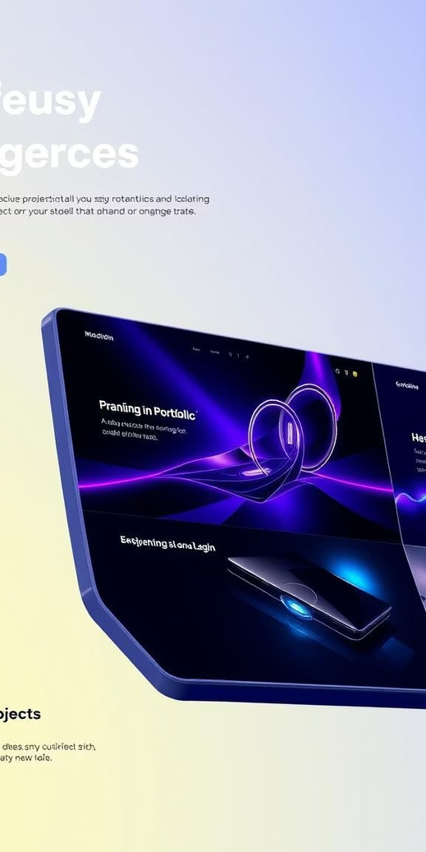

Reimagining Digital
Por tfolios
Traditional portfolios oftenlack thedynamismandengagementrequired
totruly captivatean audience intoday's fast-paceddigitallandscape. They can be static, difficult to update, and failtoconveythedepthand
scope of one's creative or professional journey.Thisprojectaddresses
the urgent need for a more interactive and compellingwaytopresent
one's work.

Slide 3
AGANDA
Problem statemen ﻿
Project overview
End user
Tools and Technology
Protfolio design and layout
Features and Functionality
Results and Screenshot
Conclusion
Github link

Slide 4
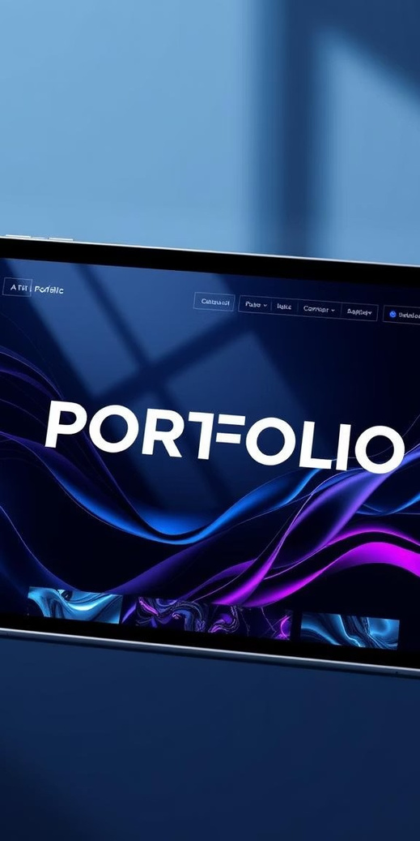
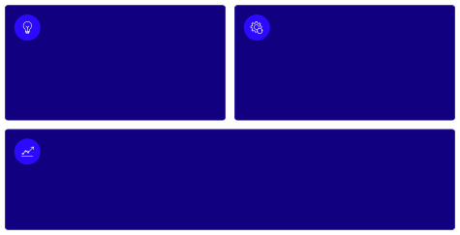
Project Overview: The Dynamic Showcase
Innovative Concept
Seamless Integration
Aresponsive,multi-format digital portfolio designed to articulate individual skills and projects with unparalleled clarity and visual appeal.
Connectsdiverseproject types, from code
repositories to graphic designs, ensuring a unified and coherent presentation across all platforms.
Enhanced Engagement
Employsinteractiveelementsand compelling visual narratives to significantly boost audience retention and
comprehension.

Slide 5
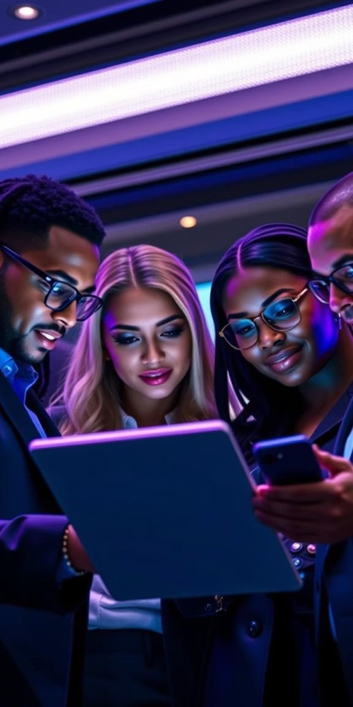

Who Benefits? Our Target Audience
Recruitment Specialists
Efficientlyreviewcandidates'work, gaining quick insights into their capabilities and project contributions.
Prospective Clients
Clearlyseepastsuccesses and creative approaches, building confidence in our ability to deliver exceptional
results.
Industry Collaborators
Explorepotentialsynergiesbyunderstanding our unique specialisms and collaborative project methodologies.
Aspiring Professionals
Serve asan inspirational example of how to effectively curate and showcase their own emerging talent.
Our digital portfolio is crafted to resonate with a diverse professional audience, ensuring maximum impact and
accessibility for every viewer.

Slide 6
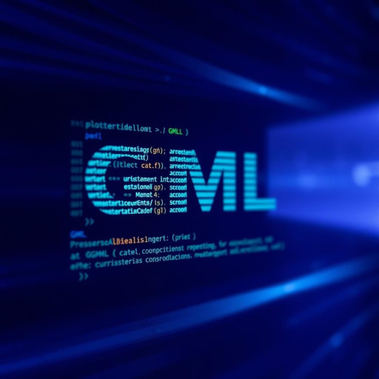
Behind the Scenes: Tools and Technology
Gamma Markup Language (GML)
Utilised foritsresponsive designcapabilities and structured content presentation,
ensuring cross-platform compatibility and visual fidelity.
Advanced Design Software
Leveraged industry-standardtools like Adobe XD and Figma for wireframing,
prototyping, and creating intricate UI/UX elements.
Custom Scripting (Conceptual)
Integrated custom scriptsfordynamic content loading and interactive features,
enhancing the user experience beyond static display.
The meticulous selection of these technologies ensures a robust, scalable, and visually stunning digital portfolio that is both functional and future-proof.

Slide 7

Design Philosophy: Elegance and Intuition
Responsive
Minimalist
Optimised for seamless viewing across desktops, tablets, and mobile
A clean, uncluttered aesthetic that puts the focus squarely on the content, reducing visual noise and enhancing readability.
devices, adapting gracefully to any screen size.
Modern
Intuitive
Incorporates contemporary design trends, typography, and colour
User journeys are carefully mapped, ensuring logical flow and effortless navigation through diverse project categories.
palettes to convey a fresh and professional image.
Every design choice was deliberately made to create an immersive and memorable experience for the viewer, reflecting the quality of the work presented.

Slide 8
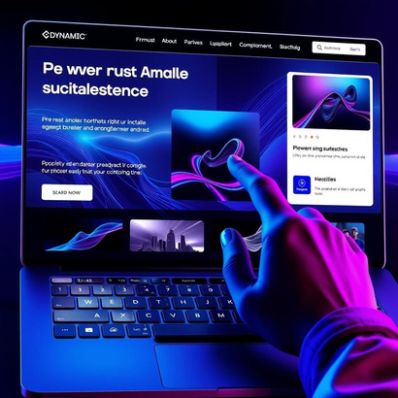
Key Features & Functionality
01
Dynamic Project Galleries
Interactive galleries allow viewers to explore project images and videos with zoom and full-screen options, highlighting visual assets.
02
Categorised Work Showcase
Projects are neatly organised by discipline (e.g., UI/UX, illustration, branding), enabling targeted browsing based on viewer interest. 03
Integrated Case Studies
Each project is accompanied by a concise case study outlining challenges, solutions, and measurable outcomes, providing context.
04
Direct Contact & Social Links
Seamless integration of contact forms and social media profiles facilitates direct communication and professional networking.
These features combine to create a comprehensive and user-friendly platform, transforming a simple portfolio into a powerful interactive experience.

Slide 9
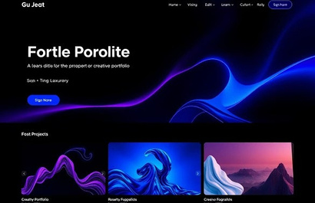
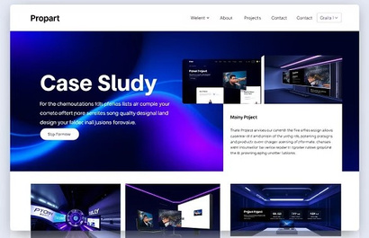
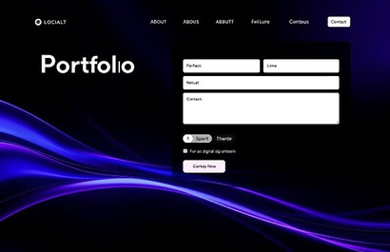
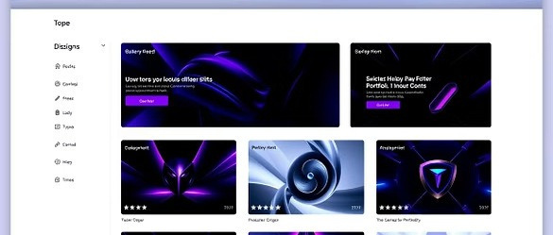
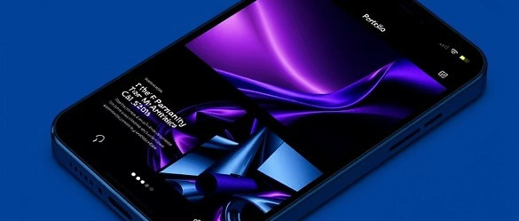
Results & Visual Showcase
Thedeveloped digital portfoliosuccessfully translates complexprojects into engaging visual narratives, receiving positive
feedbackforits clarity andaestheticappeal. Hereare someglimpsesof the final product:
The design effectively balances form and function, ensuring that each project is presented in its best light.

Slide 10

Conclusion: A New Standard for Presentation
Impactful Engagement
Future-Ready Approach
Theproject demonstrateshow a well-designed digital platform can significantly elevate how professional work is perceived and understood.
Byembracing modern web technologies and
design principles, the portfolio is adaptable to future content and viewing requirements.
Enhanced Professional Brand
Thisdynamicshowcaseservesasapowerful tool for personal branding, attracting new opportunities and
collaborations.
This project stands as a testament to the power of thoughtful design and strategic technology implementation in
creating compelling professional narratives.

Slide 11


Explore the Code
For those interested in the technical implementation and underlying
structureofthisdynamicdigitalportfolio,thefullprojectcodeisavailable on GitHub.
View on GitHub
See Live Demo
Feel free to delve into the codebase, contribute, or adapt it for your own
projects. Your feedback is highly welcome!

